Slide 1

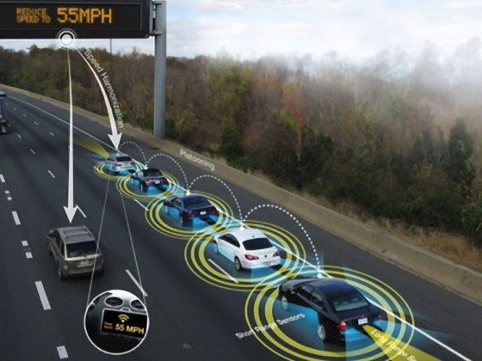


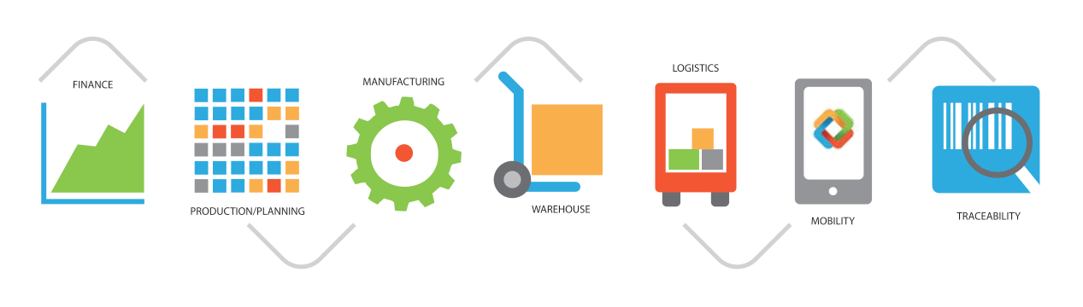


What We Can Accomplish Working Together
Patricia Hendren, Executive Director, I-95 Corridor Coalition
Transportation Research Forum
November 2, 2018
I-95 Corridor Coalition
enables agencies,
advances the industry,
and solves real transportation
challenges

Slide 2



Presentation Outline
What we know….
What we are doing about it…
Working together in times of change….

Slide 3
What We Know…
Demand is Growing
2007
2040
Source: Michael Trentacoste, Future Interstate Study Committee Meeting (Sept 2016)

Slide 4
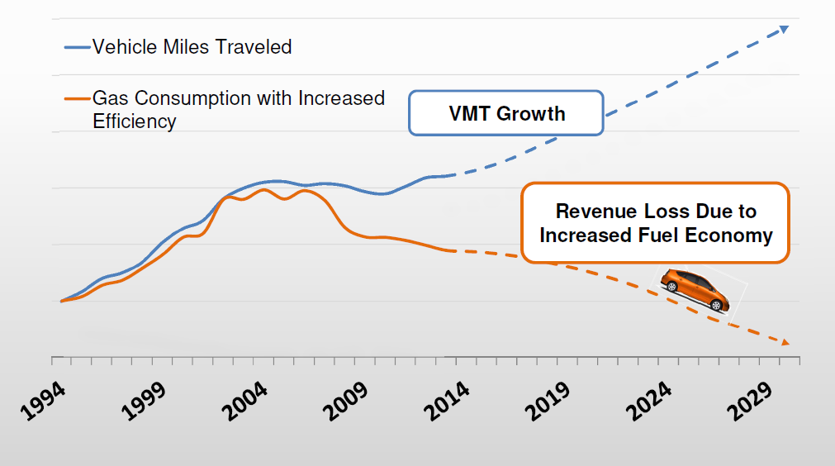
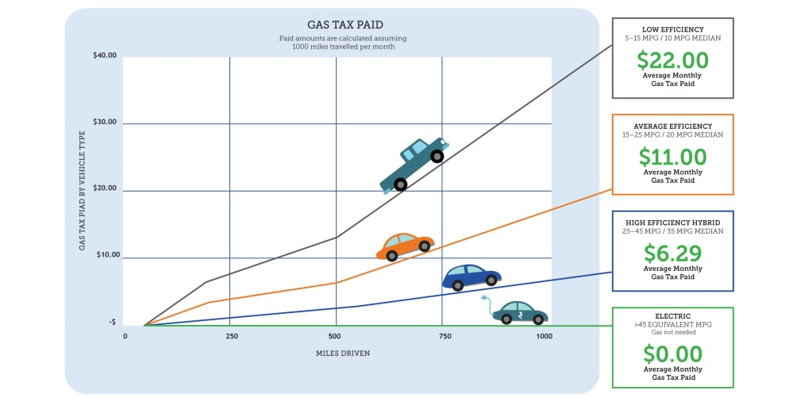

What We Know…
Transportation revenue is weakening
Source: CH2M
Federal gas tax has not been raised since 1993
Inflation
Vehicles are more fuel efficient
Electric and hybrid cars are on the rise
Drivers don’t know how much they are paying

Slide 5
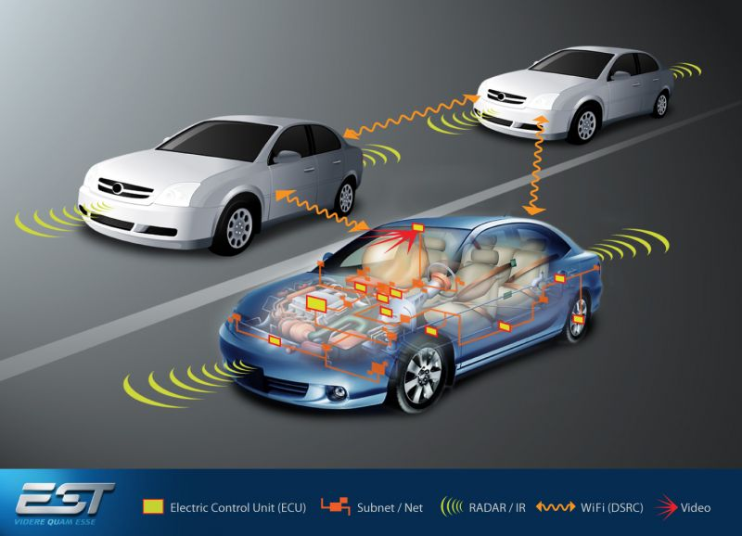
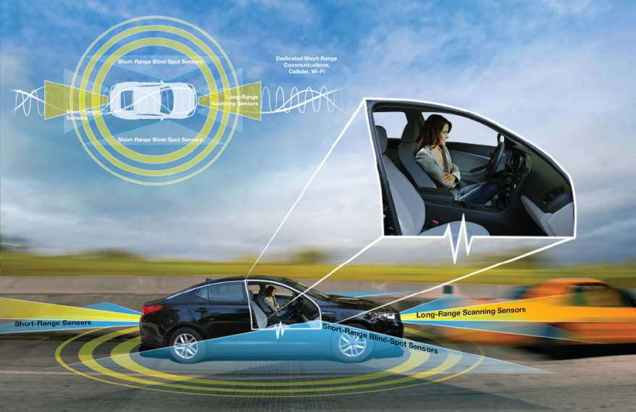
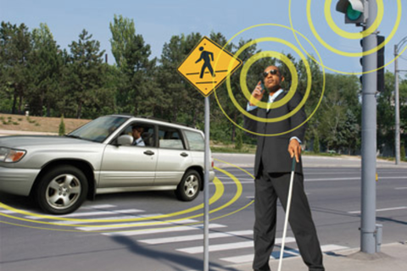
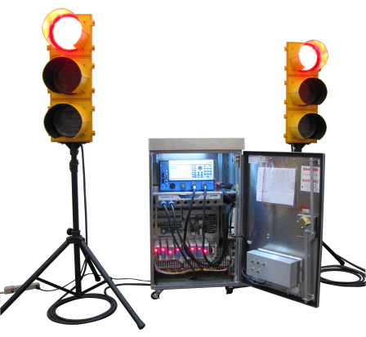
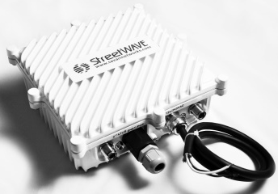
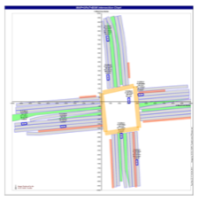
What We Know…
Technology tsunami is not a question of “if” but “when”
Connected Vehicles
Automated Driving Vehicles
Connected Travelers
Connected Infrastructure
Source: Presentation: Multimodal Intelligent Traffic Signal Systems by Dr. Larry Head, University of Arizona (June 2016)
Photo Source: http://www.its.dot.gov

Slide 6




What We Know…
Our Customers are Changing
Wearable Technology
  411 million smart wearable devices, worth a staggering $34 billion, will be sold in 2020
Smartphones
  Ownership increased from 35% in 2011 to 64% in 2015
  (92% of adults now have a cell phone or smart phone)
Ridesharing
  Revenues are expected to grow worldwide from $3.3 billion in 2015 to an estimated $6.5 billion within four years
Everything on Demand
  US consumers spend $57.6 billion a year in the on-demand economy
Notes:
Waze: Founded in 2007
Users: 65 million active users (10/11/16)
Number of Countries Waze has users in: 185 (11/25/16)
Number of Countries Waze has 20,000+ monthly active users in: 38
Waze was purchased by Google in 2013 for (drum roll here...) $1.15 billion

Slide 7



Currents Pushing Innovation in Transportation
Technology
???
Driver
Funding

Slide 8
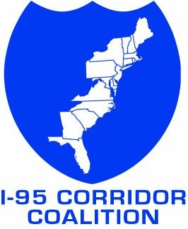
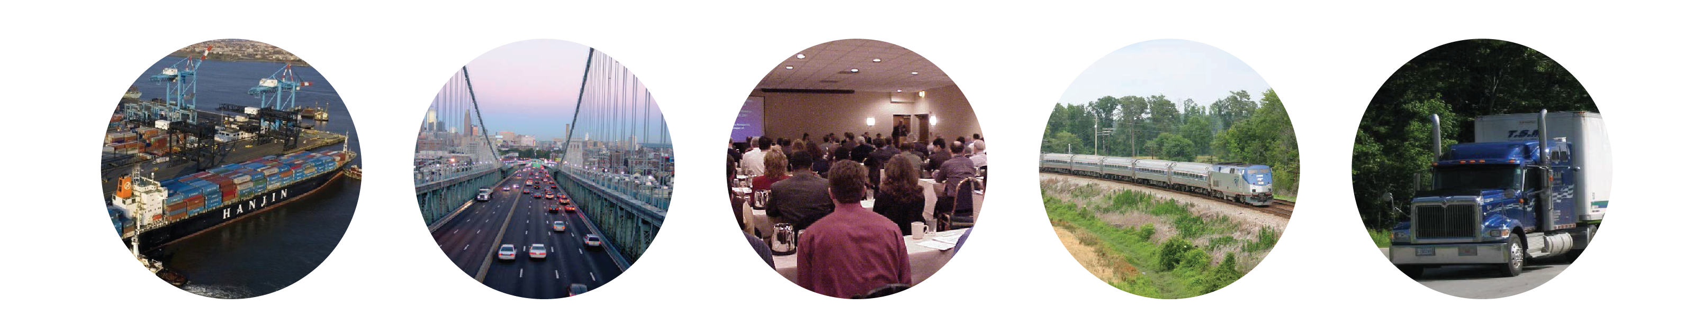
The Coalition is more than I-95 ……
What We Are Doing…
Multi-modal Multi-jurisdictional Multi-disciplinary
Formed in 1993, the I-95 Corridor Coalition is a partnership of multi-state, multi-modal public agencies working together to create a seamless and efficient transportation system.
Notes:
A partnership organization that stretches from ME to FL with over 100 multimodal members including:
State DOTs,
MPOs
Toll authorities
Transit
Law enforcement
DMVs
Railroads
Public Safety/Law Enforcement officials
For 25 years, the Coalition has worked to improve passenger and freight movement along the east coast….. Why is this important?

Slide 9
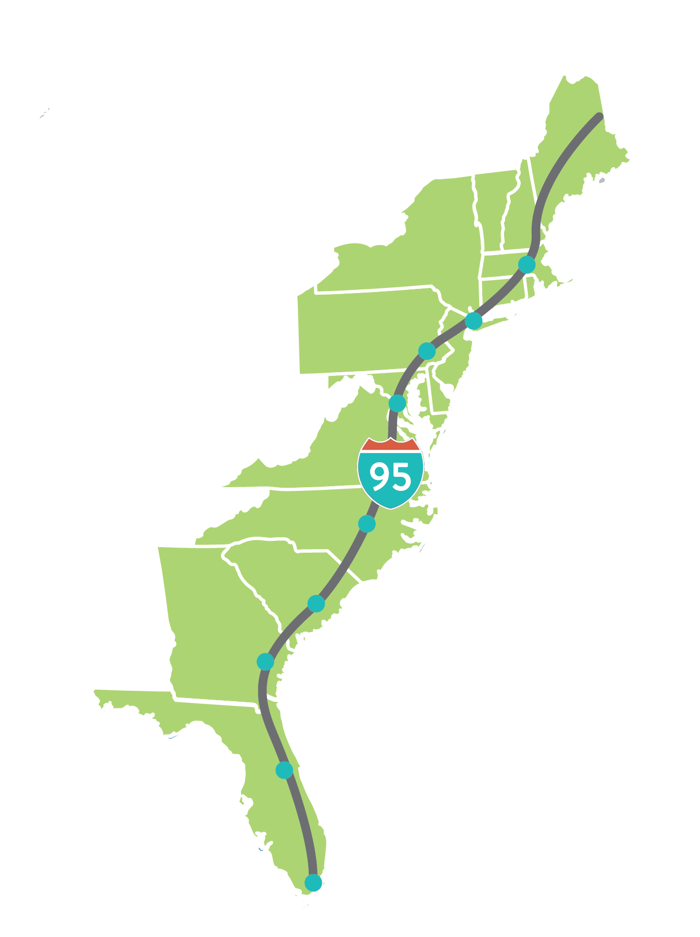
16 states + D.C.
In the Corridor
Boston, Massachusetts
2nd
Largest Economy in the World
New York, New York
Philadelphia, Pennsylvania
Washington, D.C.
$4.7 Trillion
40% of US GDP
37%
Raleigh, North Carolina
46
Of America’s population:
110 Million people
Charleston, South Carolina
Savannah, Georgia
Major Seaports
$172 Billion Imports
34% of U.S. total
Orlando, Florida
Miami, Florida
Notes:
Heartbeat of economy
40% of GDP
1/3 of nation’s VMT
1/5 of all roads
2008 from the 2004 GDP, BTS info, and TTI 2005 Mobility Study

Slide 10
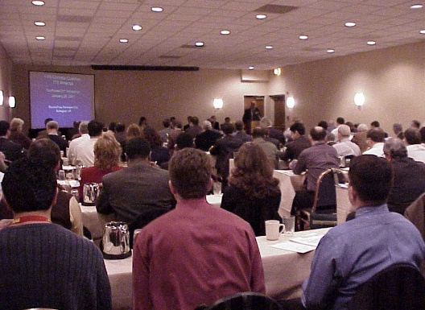

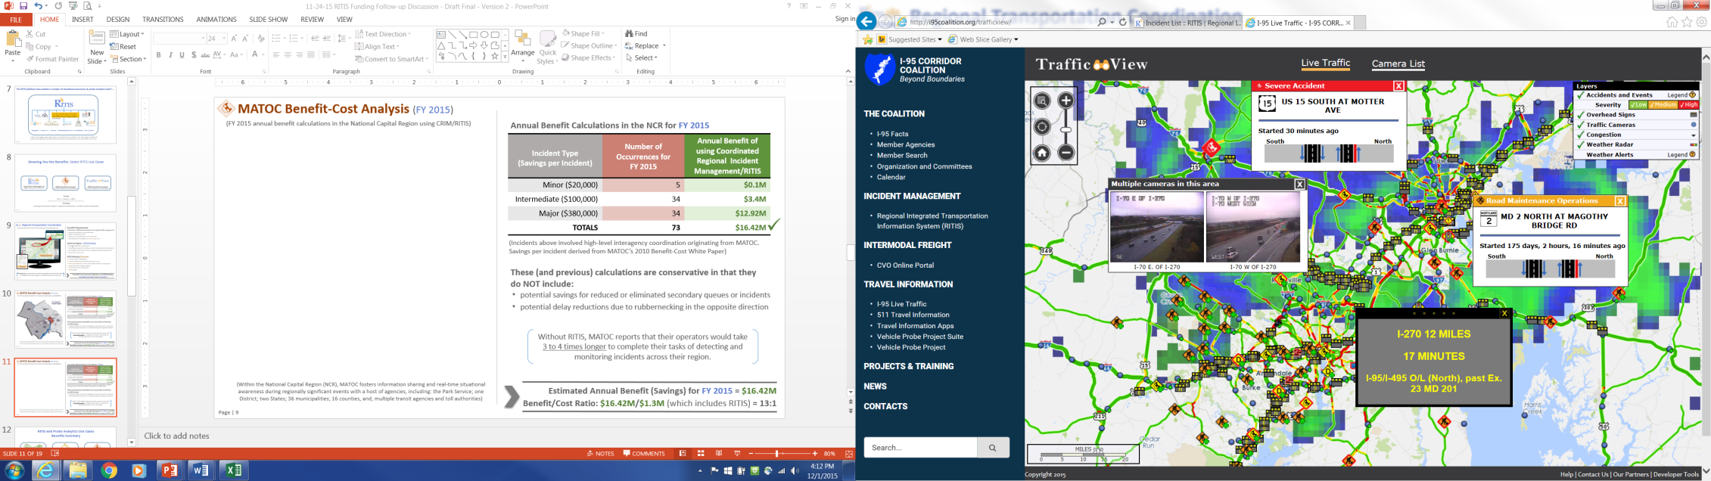
25 years of……
In short, the I-95CC helps agencies tackle the sticky issues and get solutions across the finish line.
PEOPLE
Create a forum for public agencies to address transportation issues of common interest
Establish a key network of transportation professionals
Provide training (e.g., Freight Academy)
TOOLS & DATA: Support data acquisition and tool development
RESOURCES
Compete for grants
Extension of agency staff
Partner with FHWA to explore policy implementation

Slide 11
I-95 Coalition Structure
Executive Board
Chair & 4 Vice-Chairs
Executive Director
Coalition Staff & Consultants
Steering Committee
Program Tracks
Transportation Systems Management & Operations
Operations Exchanges
Traveler Info
Data Tools & Research
Operations Academy
Innovations in Transportation
Connected & Autonomous Vehicle
Tolling Reciprocity
Mileage-Based User Fees
Intermodal Freight
Freight Plans
Freight Fluidity
Truck Parking
Freight Academy
Notes:
Freight Plans

Slide 12
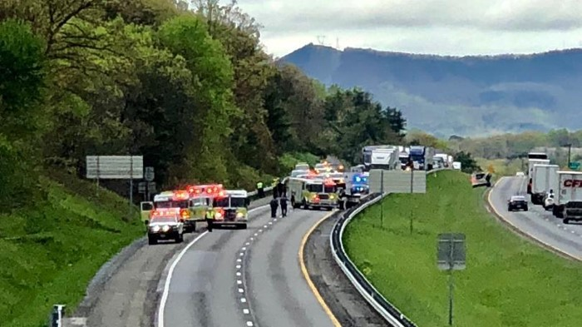
TSMO Track
Notes:
The heartbeat of the Coalition is Operations…. Or as it is now referred to as Transportation Systems Management & Operations
"a set of integrated strategies to optimize the performance of operations on existing infrastructure through implementation of multimodal, cross-jurisdictional systems, services, and projects designed to preserve capacity and improve security, safety, and reliability of a transportation system." In simplest terms, TSMO is a way to address reliability, mobility, and congestion by utilizing strategies rather than only building out of congestion.

Slide 13
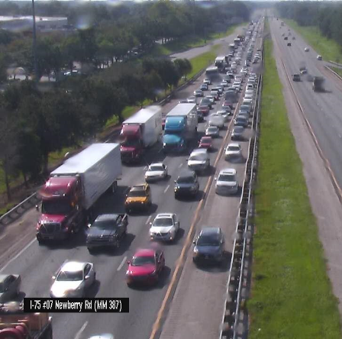
Highway Operations Group: HOGs
applying TSMO strategies along the east coast
What strategies are we looking to implement regionally and have we started the discussion amongst our neighbors?
Emergency Shoulder Use
Wind Alerts and Messaging Systems
Evacuation Routes
Detour Routing
Traveler Information (i.e. Gas Buddy)
FIVE HOGs Regions
Potomac (Oct 2018)
Delaware Valley (Nov 2018)
Southern (Feb 2019)
New England (TBD 2019)
Tri-State (TBD 2019)
Hurricane Irma- September 2018
Emergency Shoulder Evacuation Routing
Courtesy of FDOT
Notes:
Emergency Operations is becoming a more prevalent TSMO strategy.
Recently we held an exchange in Atlanta where members from the states of FL, Al, GA, SC and NC participated and discussed methods used in the hurricane evacuations and how to improve communications cross borders when deploying evacuation strategies.
As emergency weather events become more prevalent, the agencies need to look at how they can better coordinate both communication and resource allocations in the respective regions.
We are working to develop resiliency tabletops that address infrastructure, weather and significant event response

Slide 14




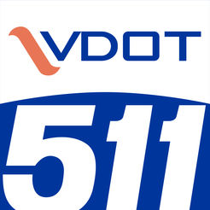


Traveler Information
applying TSMO strategies along the east coast
Notes:
The need to inform the public of events occurring on the roadways is an important TSMO strategies.
Both the public section and private developers are working hard to bring all types of events that affect the roadway network to the public
There has been much discussion about the use of WAZE for trucking and how this application creates diversion routing onto non-freeway segments
The member states come together to discuss how they are providing information to the traveler relative to all types of Strategies such as TIM, R&W, etc.
Each year, we hold two in-person meetings that focus on agency traveler information programs – one meeting focues on a specific topic – Last year we held a Crowdsourcing summit where agencies talked about how they were using WAZE as a trav info app.
The TIS Annual meeting is held in March and this meeting focuses on an agency roundtable that highlight new programs within the member agencies since the last roundtable the year before.

Slide 15
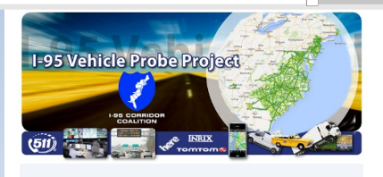




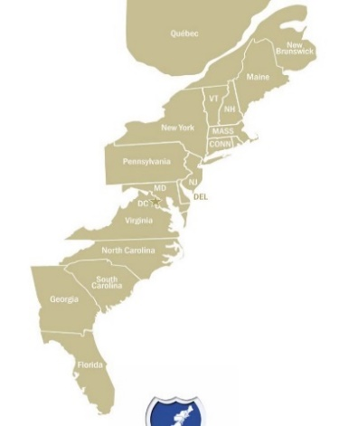
Data Tools, Research and Webinars
applying TSMO strategies along the east coast
Data Access
    VPP Probe Data Marketplace & Validation
Turning Data into Information
    PDA & RITIS User Groups
Topic Specific Webinars
    Work Zone National Webinar
    Leveraging GTFS with Regional Partners
    TSMO Dashboard
    Data tools for Road and Weather Operations
    Computer Aided Dispatch Data Integration
Beyond Boundaries
Advanced CAD Integration
Beginning CAD Integration
Notes:
15
Denise to review
Upcoming Meeting
Reminder
Use the Probe Data Analytics Suite tools to help travelers better plan for a less stressful trip by using Trend Map and Congestion Scan to evaluate previous holiday travel and suggest the best times to travel (and what times to avoid) major recreational corridors for this year.

Slide 16
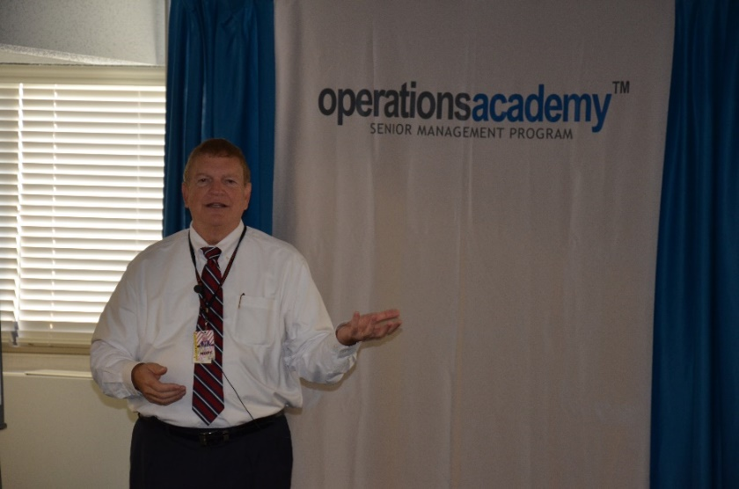
Operations Academy Scholarships
applying TSMO strategies along the east coast
201 Session
Overall
ME
NH
VT
NY
MA
CT
RI
PA
NJ
MD
DE
DC
VA
“A safe and efficient transportation system is vital to our national prosperity, and modernizing it to meet our 21st century demands has become our most significant mobility challenge. The Ops Academy has answered this challenge by providing an interactive educational forum where transportation professionals can develop advanced skills, and champion efforts to realize the future. I returned to my agency with a number of new concepts and techniques to bring disparate TSMO efforts together.”
2017 Academy Graduate from New York State DOT
NC
SC
0-5 Scholarships
GA
6-10 Scholarships
11-15 Scholarships
FL
16+ Scholarships

Slide 17
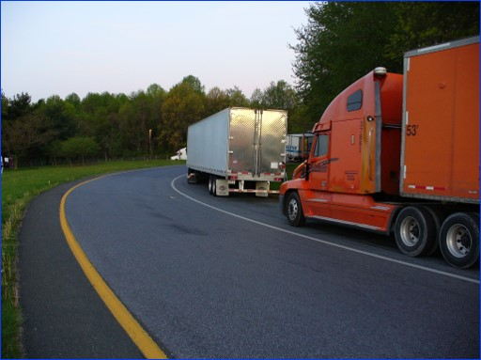
Freight Track

Slide 18
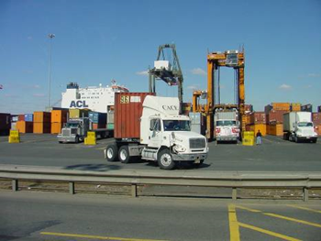
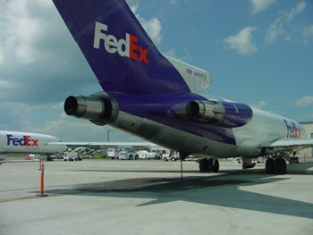
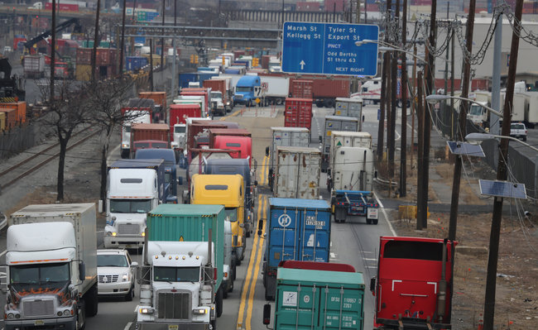
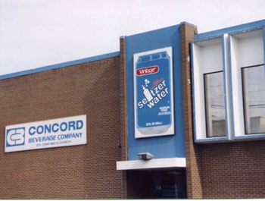
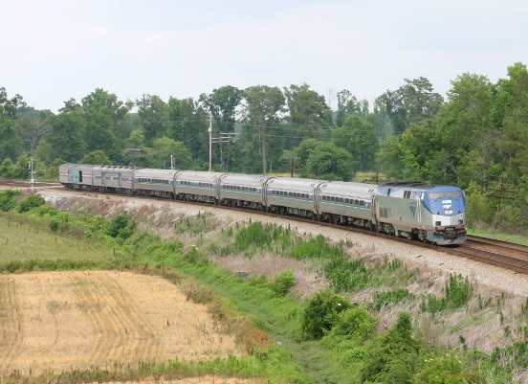
Addressing Freight Challenges along the East Coast
Freight Planning
M-95 Marine Highway
Freight Data: Supply Chain Performance
Truck Parking
Notes:
There are five core TSMO strategies that are integral to the management of any transportation network and they are:
Traffic Incident Management or TIM - Road and Weather Operations - Construction Work Zone Management (also known as Work Zone ITS)
Traveler Information and Emergency Operations
Throughout the year, the Coalition holds regional exchanges and provides data tool webinars that support development and education of these strategies amongst the members.
How do we do this? Through Member input to individual program and overall Coalition work plan/activities – which provided transparency
Why do we do this? To improve Cross-Coalition Program Communication
Providing awareness to individual committee members of other Coalition program committee activities
Insuring coordination to leverage committee work, avoid redundancy/gaps in activities/efforts
All of these

Slide 19

State Freight Plans
Data is a BIG issue
Freight Advisory Committee GREAT
Need more coordination
Staff expertise lacking
REPORT AVAILABLE
Get your elevator speech ready!

Slide 20
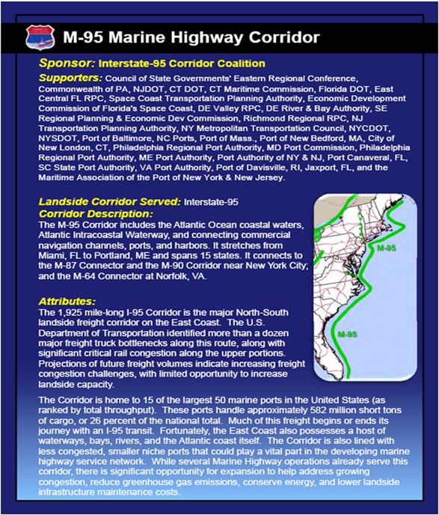
M-95 Marine Highway Corridor
I-95 Corridor Coalition and its geographic region designated by USDOT in 2010 as “M-95 Marine Highway Corridor”
Extends Florida to Maine– including ports, harbors, inland and inter-coastal waterways along the Atlantic Coast
Coalition role:
  Coordinator, facilitator, educator, information sharing “neutral party” between multiple jurisdictions and stakeholders
Coalition agencies use this designation to advance projects:
  Port of Virginia/Richmond MPO James River Barge Service operational since 2010
  August 2018 USDOT awarded funding to projects in NY, CT, RI and VA
Notes:
Davisville/Brooklyn/Newark Container-on-Barge Service (awarded $855,200)
Sponsored by the Quonset Development Corporation, this service will run between Brooklyn, N.Y., Newark, N.J. and the Port of Davisville in Rhode Island. The service will include a dedicated run twice a week utilizing one 800-TEU capacity deck barge and will remove approximately 83,200 containers and 14,976,000 vehicular miles annually from the road. It will also relieve landside congestion and lower transportation costs for shippers while providing additional economic opportunities regionally.
James River Expansion Project on the M-64 (awarded $456,000)
Sponsored by the Port of Virginia, this regularly scheduled service operates three times a week between terminals in Hampton Roads, and the Richmond Marine Terminal. The grant will allow the service to continue expanding by increasing freight handling capacity at the Richmond Marine Terminal, enabling it to provide a more efficient level of service.
New York Harbor Container and Trailer-on-Barge Service (awarded $298,423)
Sponsored by the New York City Economic Development Corporation, the grant will assist with funding a planning study to look at how marine highway services can be expanded throughout the Northeast region from New York Harbor to other points. Since many of the terminals at the Port Authority of New York and New Jersey are reaching capacity; the study will provide the data necessary to establish the business case to support shipping container movement by barge between terminals and beyond. Services derived from this study could reduce landside congestion, provide greater market access and improve terminal capacity and efficiency.
Cross Sound Enhancement Project (awarded $503,250)
Sponsored by the Connecticut Port Authority, this grant will support the improvement of the Cross-Sound Ferry by expanding the dock and supporting infrastructure. The project will focus on maintaining and improving operational safety and efficiency. The grants funding will be utilized for shoreside infrastructure improvements and more efficient direction of vehicular traffic.

Slide 21
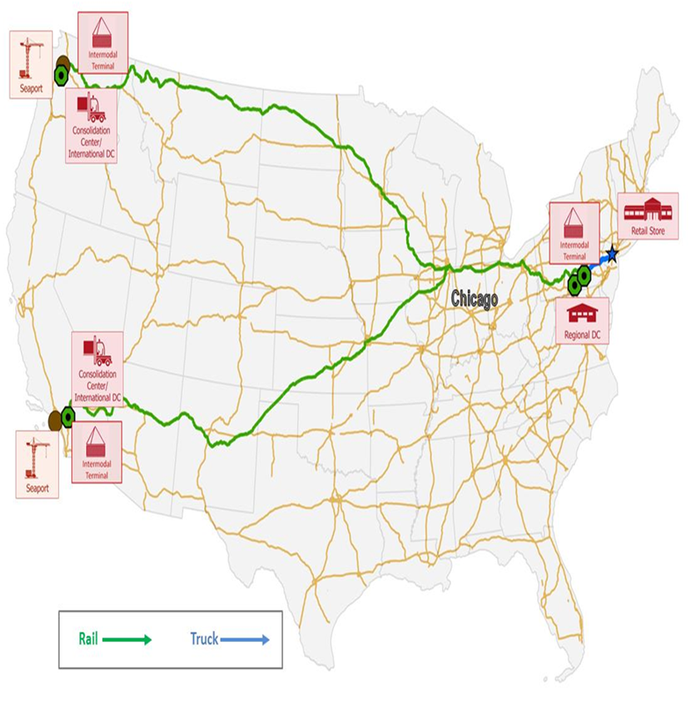
National Freight Fluidity Monitoring Program
Project Goal: move supply chain performance monitoring from theory into real-world applications
Two tracks:
1) National supply chain performance monitoring
  Select “market basket” of supply chains
  Establish data sharing and procurement agreements
  Collect and track three supply chain measures
    Time
    Cost
    Travel time reliability
  Produce quarterly reports for monitoring
2) State /Regional Pilots
  Test feasibility of applying national monitoring measures locally
  Two pilots: metropolitan Chicago and metropolitan New York

Slide 22
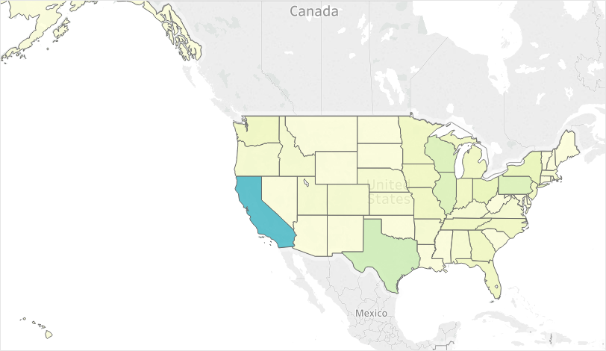
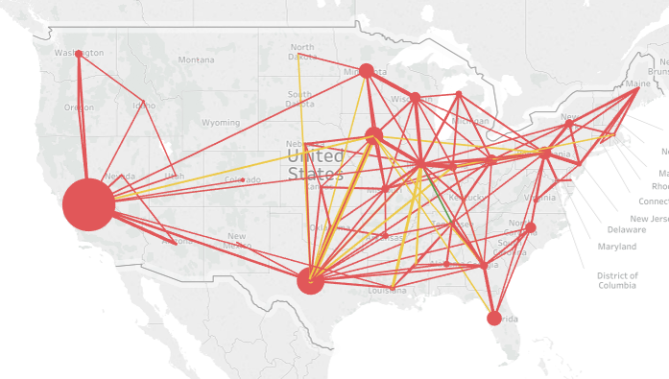
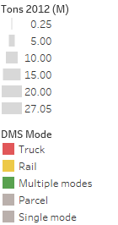
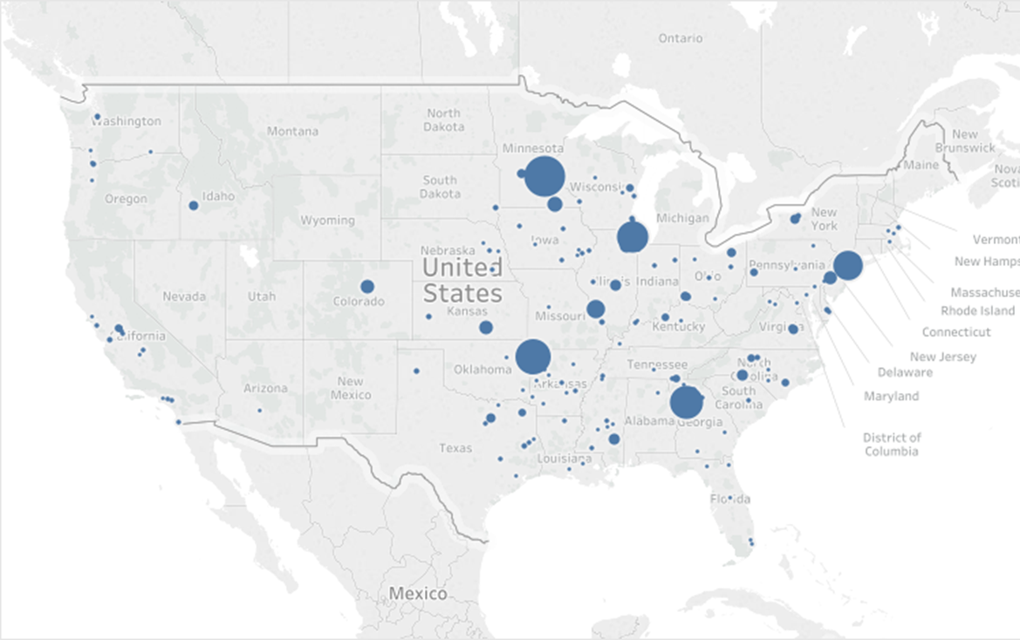
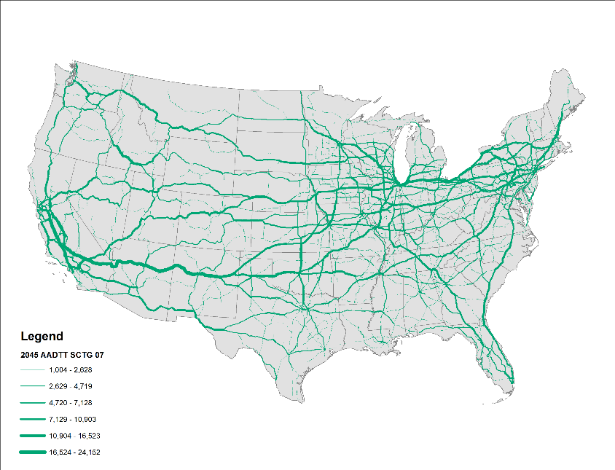
Industry Sector Example: Food Products Manufacturing
Definition: NAICS 311-2
Typical Commodities: fresh, frozen, or processed meats, poultry, fish, fruits, vegetables; milled grains/oilseeds; sugars; baked goods; beverages
Representative Supply Chains: Anheuser-Busch, Coca-Cola, Perdue, General Mills
EMPLOYMENT BY NAICS (CBP)
FAF O/D DENSITY
PLACEHOLDER
LOCATION OF FIRMS OVER 1,000 EMPLOYEES BY NAICS (INFO USA)
2012 TONS (OVER 0.25 M) BY MODE (CFS)
NAICS GDP | Trade Share (CFS Value) | D Modes (CFS Ton-Miles) | Tons and Avg Dist (CFS)
$493 B | 4% E, 96% D or I | 68% T, 20% R, 12% O | 706 M tons, 440 miles
FAF SCTG 7 HWY FLOWS

Slide 23
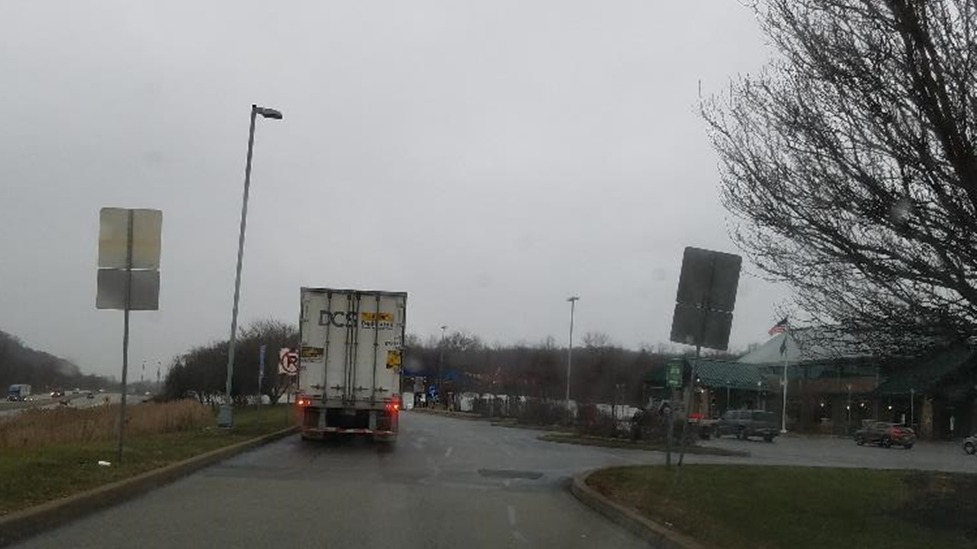
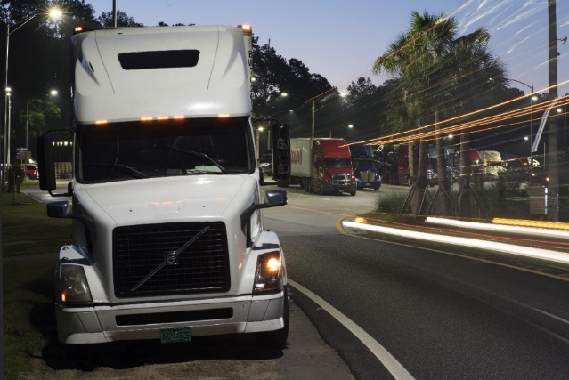
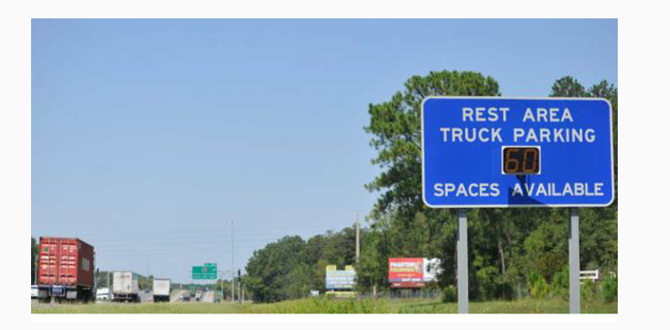
The Truck Parking Challenge
“Without trucks, you would be homeless, hungry, and naked.”
Too many trucks, not enough parking spaces
Long-haul vs. staging vs. short-term parking – different needs
Lack of reliable, real-time information on where to find available parking
Public need (safety, infrastructure) vs. perception of private solution (~80-90%)
40% in freight movement in next 30 years
Cost of land / real estate
“NIMBY” effect
ELD enforcement as of April 1
Notes:
Big overall need is lack of capacity – this is a difficult topic for public sector as many see truck parking as a private sector issue with a private sector business solution (80-90% of parking capacity is provided by private sector)
Better information can help address some of this concern

Slide 24
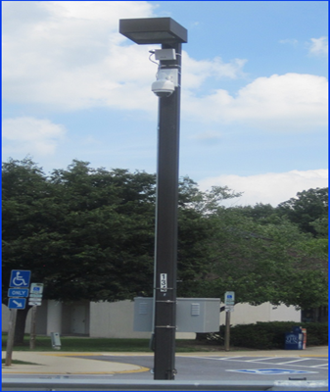
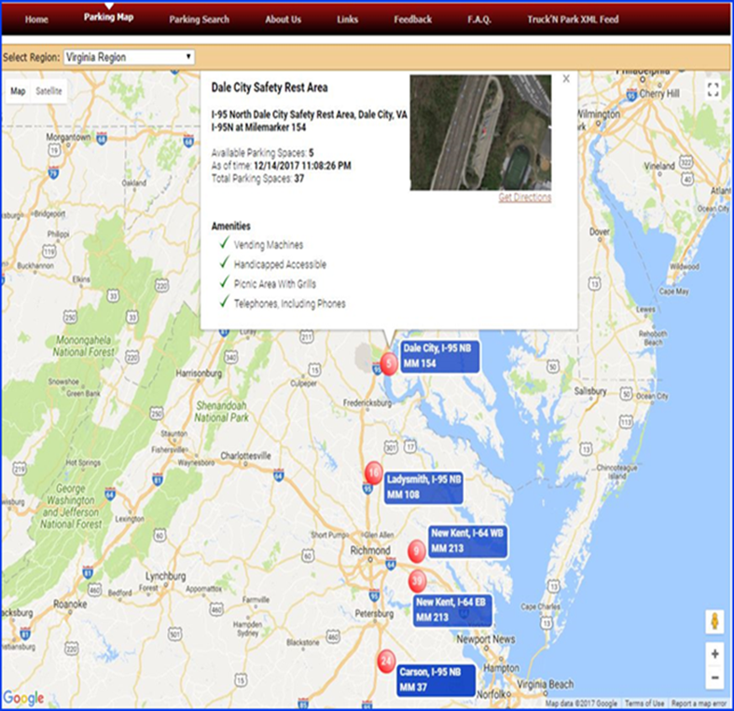
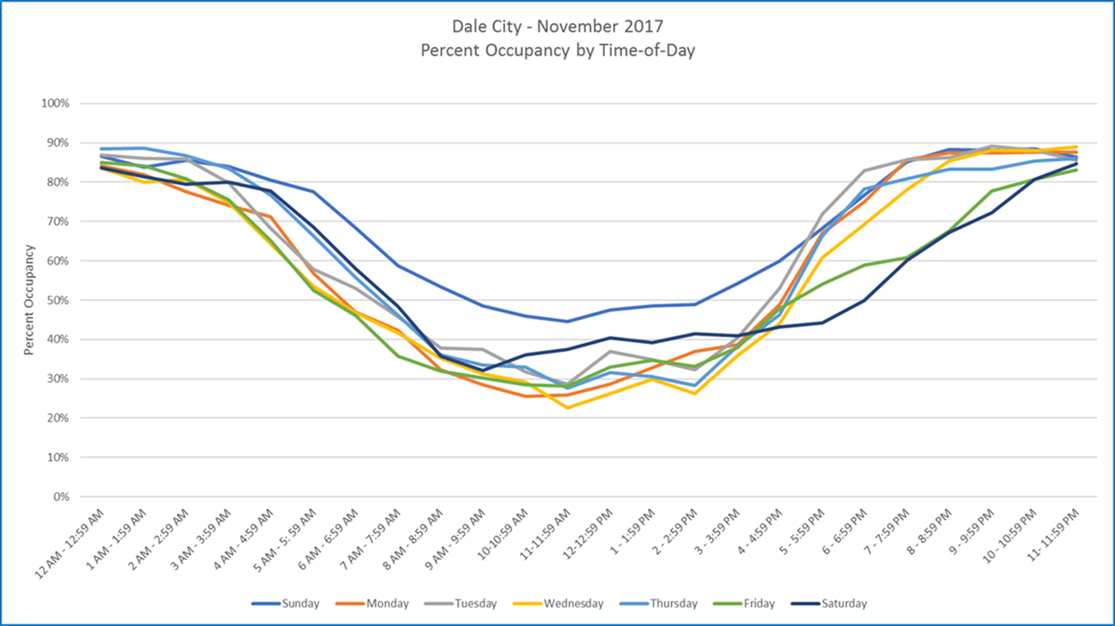
Advancing Real Time Truck Parking Information
I-95 Corridor Coalition awarded Truck Parking Grant from FHWA
  Conducted a “Proof of Concept“ Test and Deployment of Real-Time Truck Parking System
  System deployed in five rest areas in Virginia – currently fully operational
  Coalition project system has been Integrated into Virginia DOT’s Statewide ATMS
  Virginia DOT now has oversight and continued operation and maintenance for system

Slide 25
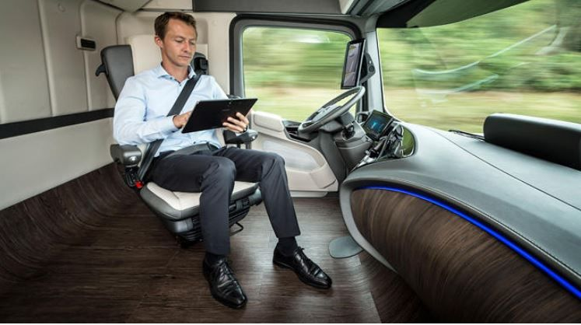
I-95 Coalition Truck Parking Workshop
May 2018
Share recent truck parking activity – who is doing what and is it working?
Develop list of key truck parking attributes
Identify opportunities, barriers, challenges and solutions of various approaches
Discuss how changes in regulations and technology could change future needs
Brainstorm ideas and stakeholders for 2019 Symposium
Build on National Truck Parking Coalition Work
Over 40 participants from member DOTs, FHWA/FMCSA, select MPOs, and other key stakeholder
Notes:
Breakout groups:
1) Expanding Parking Capacity
2) Design Options
3) Information Distribution
4) Data Decisions
5) Outreach and Education

Slide 26
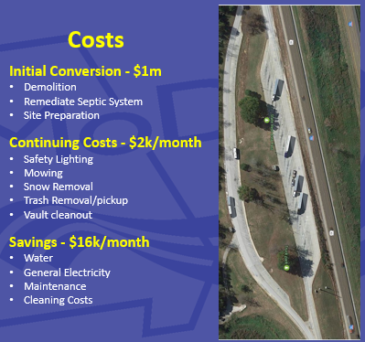
Insights from Recent Activity
REPORT AVAILABLE
Get out and TALK TO DRIVERS
View truck parking (and approach the need for more) as an economic development concern
Find “easy” wins
    Increase time limits at public rest areas
    Convert welcome centers/weigh stations
    Reduce zoning hurdles
    Underused commercial parking lots or urban brownfield sites
Best technology for parking detection/information distribution depends on …… A LOT of variables
    Ex: Roadside sign placement – more complicated than initially thought
Continually look for innovation
    Ex: US Army Corps of Engineers Pavement?
Missouri DOT: cost and cost savings from decommissioning a rest area/welcome center and changing it to truck parking only.
Notes:
EDA/IDA- Economic Development Agency/Industrial Development Agency
The commercial parking and urban brownfield “easy” win addresses more staging/short-term parking needs than long-haul which was the focus of most of the conference. However, with potential of truck platooning/automation more likely to reduce long-haul needs faster, the this type of parking need may grow
Costs are from MoDOT
USACE is using pavement to quickly build runways overseas – could this be useful for truck parking? Lower cost than asphalt but allows for striping (which cannot do with gravel). MoDOT is working with them on this.

Slide 27
Freight Academy (April 1 – 5, 2019)
What? Six-day immersion program to ensure current and future public-sector decisions and investments are made with an understanding of the comprehensive supply chain.
How? Three components
  Pre-program review and assignment
  In-person instruction by private sector executives and multiple field visits
  Capstone project
Who ? (~200 total)
  Attendees from Coalition states and MI, CO, IA, MN
  State DOTs, MPOs, economic development agencies
  USDOT participants: FHWA (HQ and Divisions), MARAD, BTS
  Funding: FHWA, AASHTO, and I-95 Corridor Coalition
“In one completely packed week, the Freight Academy exposed me to facets of the freight system I hadn't previously considered and allowed a firsthand look at other aspects I had only been able to read about. The speakers were extremely knowledgeable and each site visit was eye opening.”
Gabriel Sherman
Freight Plan Coordinator
MassDOT

Slide 28
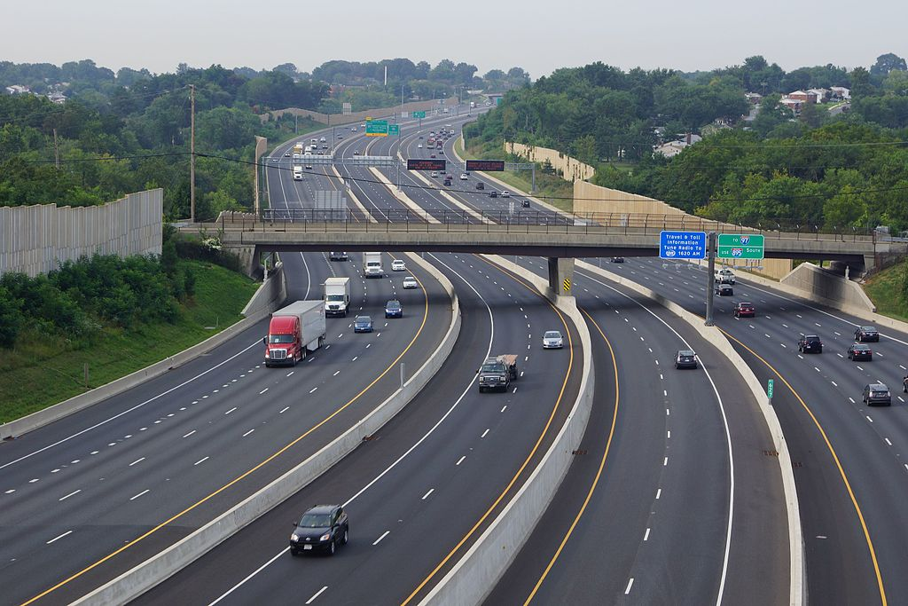
Innovation Track
Notes:
What are some areas of common interest under the Coalition’s Innovation Program Track?
Briefly mention 2: CAV and MBUF

Slide 29
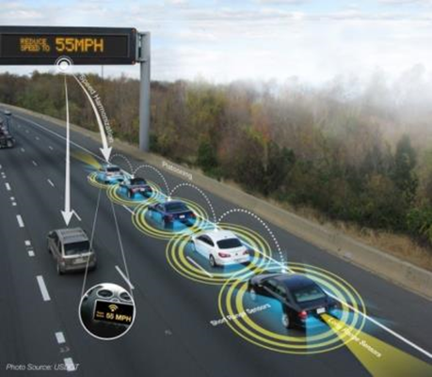
Connected & Autonomous Vehicles
Why should we care?
More mobility options
Reduce and mitigate crashes
Land use opportunities
(eliminate parking)
Expanded roadway capacity and enhanced traffic flow
This IS happening
Fuel efficiencies and reduced emissions
Attract business
to your state

Slide 30


CAV Activities….
2016 CAV Conference
Visit with members to ask “what do you need?”
2017 CAV Workshops
  “What Agencies Need to Do TODAY for the Connected
  and Autonomous Vehicles of Tomorrow”
Launched CAV Working Group
May 2018 Webinar
  A-Taxis in Greenville
  Insurance Provider Perspective
  Round-robin
Nov 2018 Webinar
  CAV Strategic Plans
  Capability Maturing Model for CAV
  Round-robin

Slide 31



I-95 Coalition CAV Focus Areas
(1) Share CAV-related activities
(2) Define implementation steps for member agencies and the Coalition
(3) Highlight what to pay attention to…. and what not to
Notes:
Four main discussion areas:
Infrastructure and Asset Management
Systems, Data, Communications/Networks
Education/Outreach and Key Stakeholders
Policies, Legislation, and Planning
Over 40 participants
15 State DOTs
Maryland Transportation Authority
Baltimore Metropolitan Council
Pennsylvania Turnpike Commission
Port Authority of New York and New Jersey

Slide 32










Toll Violation Enforcement Reciprocity
Advance violation enforcement reciprocity agreements
Bring stakeholders together
Leverage existing work and partners
Gather and share information across members
Focus on legislative, political and cross-agency
challenges
State with Tolls
Outlining our path forward
Everyone pays their tolls
Getting together

Slide 33
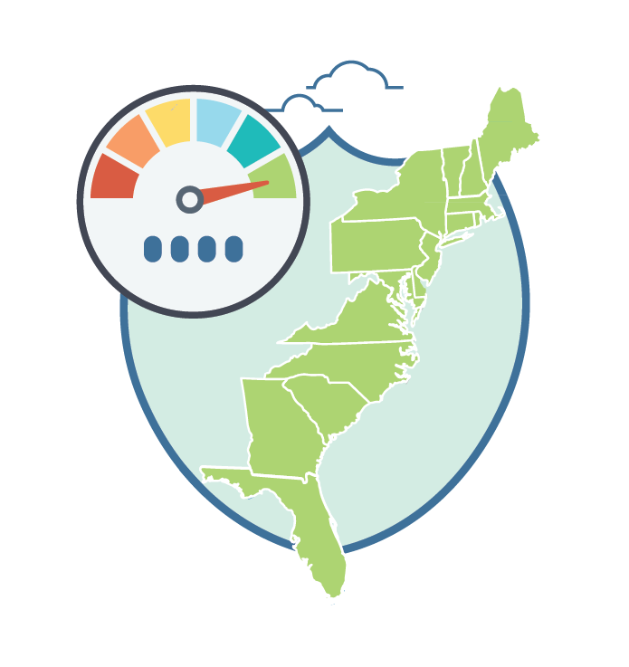
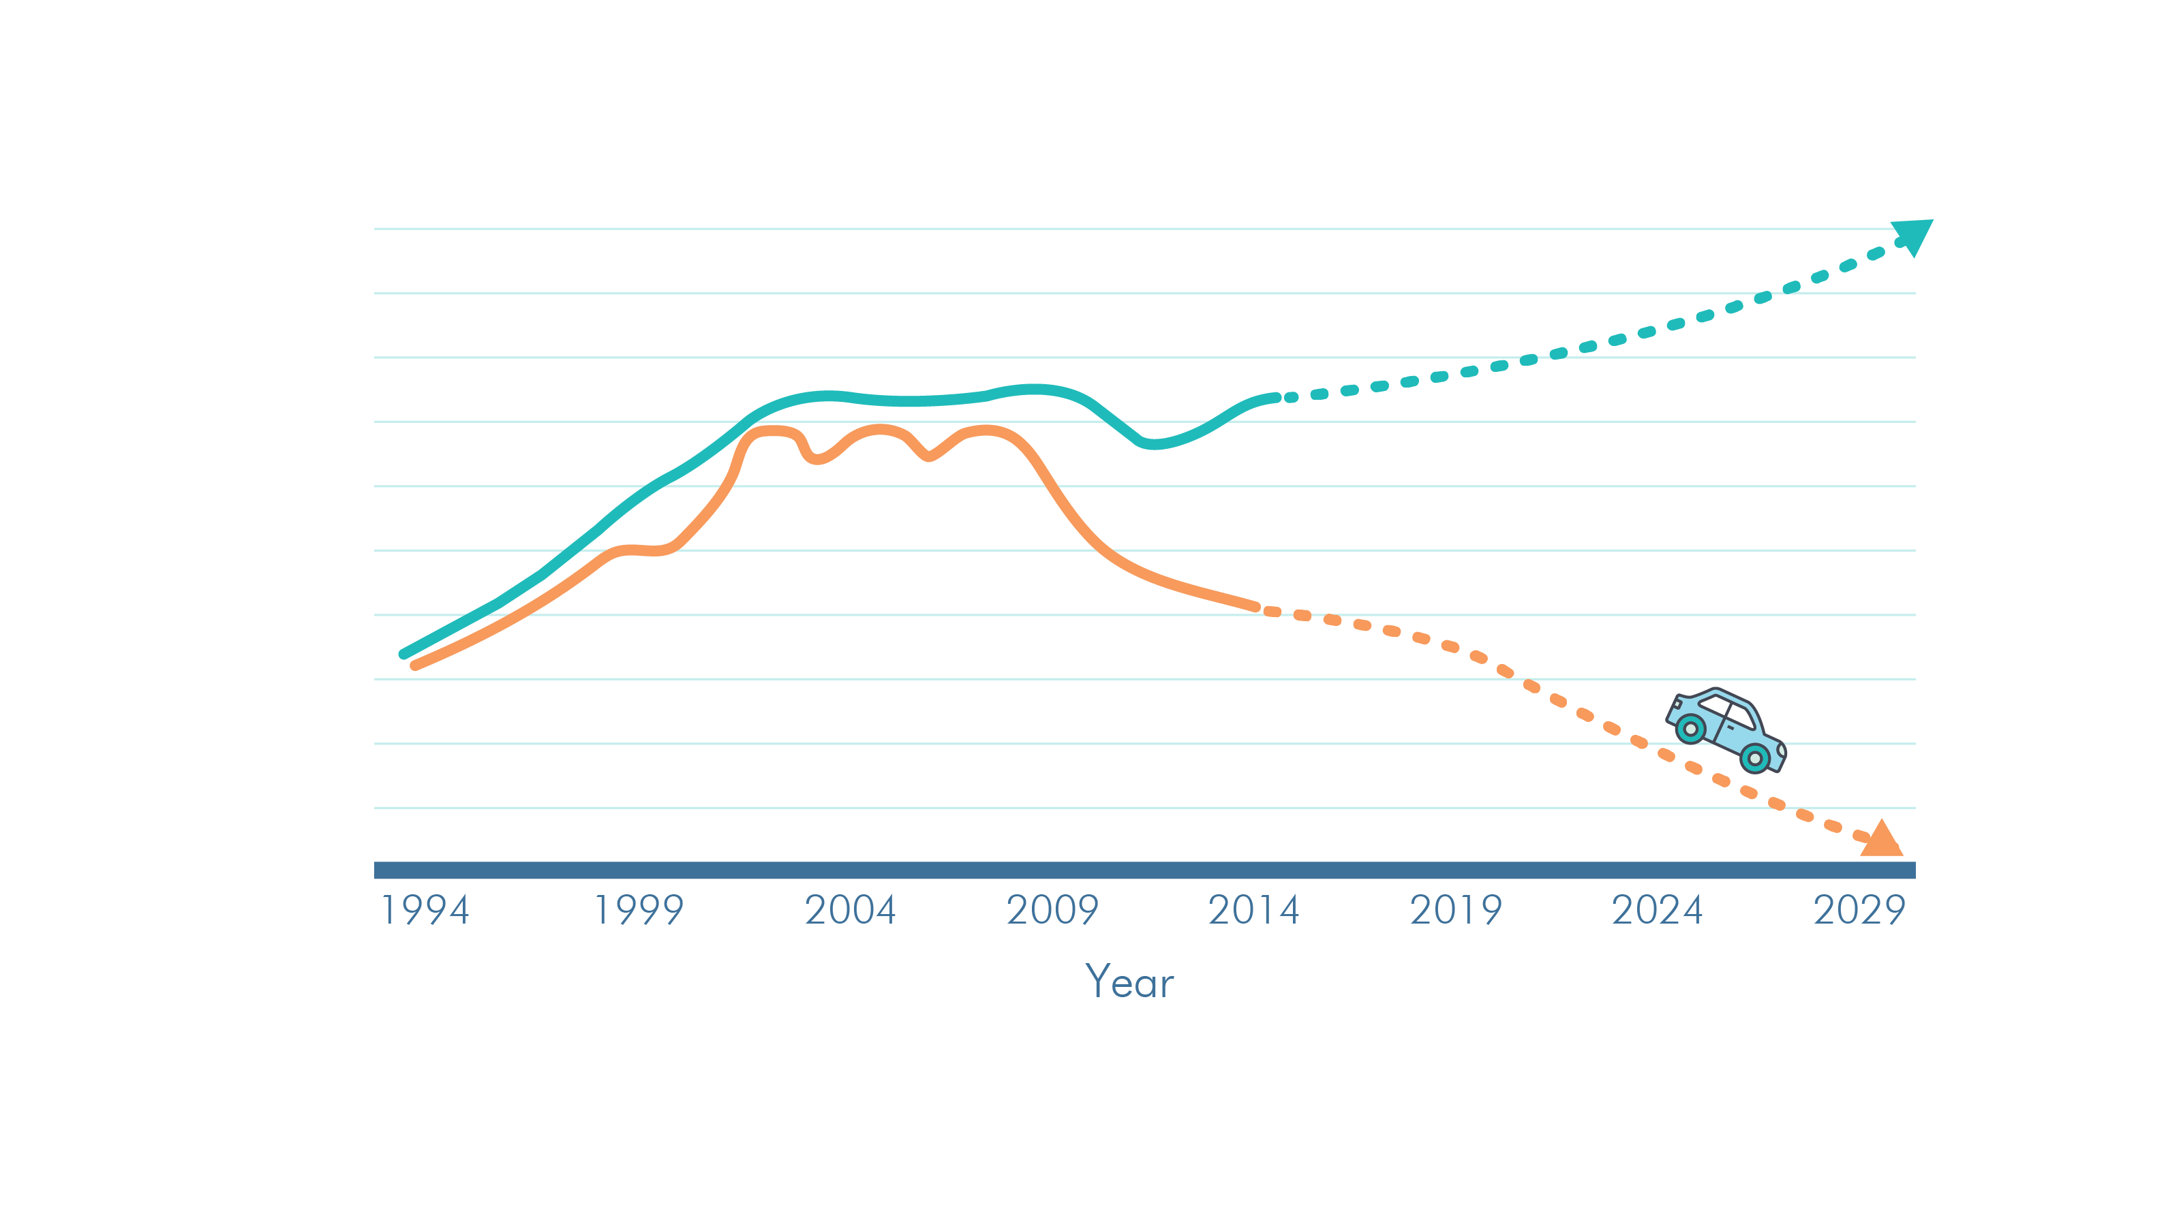
TRANSPORTATION REVENUE IS DECLINING
VMT Growth
Vehicle Miles Traveled
Gas consumption with
increased efficiency
Revenue loss due to increased fuel economy
Notes:
Our revenue is weakening.
Our highway and road funding is almost entirely reliant on a gas tax which is paid each time we fill up our car.
Our vehicles are using less gas. Even as VMT continues to grow, annual gas tax revenue continues to drop. We are using less gas. Great for the environment but as the trend continues our infrastructure suffers.

Slide 34
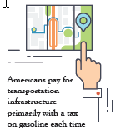
I-95 Coalition STSFA Grants
Purpose: Explore the feasibility of replacing the gas tax with a mileage-based user fee program in a multistate environment
OUT-OF-STATE MILEAGE
How will travel across boundaries be handled?
TOLLING
What is the relationship between tolling and MBUF?
TRUCKING
How does a user-fee fit into current requirements?
AMENITIES
Will value-added amenities help with public acceptance?
Awarded two grants!
I-95 Corridor Coalition Mileage-Based User Fee Study
Notes:
The I-95 Coalition applied for and received funding through the USDOT “Surface Transportation System Funding
Alternatives” (STSFA) program.
The Fixing America's Surface Transportation (FAST) Act is a funding and authorization bill to govern United States federal surface transportation spending. It was passed by Congress on December 3, 2015, and President Barack Obama signed it on December 4.
Our work has four primary focus areas.

Slide 35

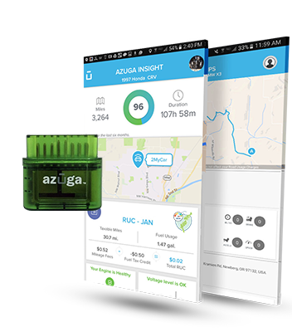
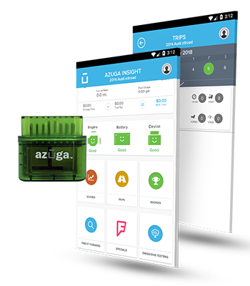
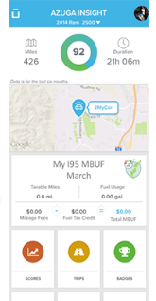

Phase I Pilot: May 1 – July 31*
155
participants
76%
Plug-In Device
with Location
13
coalition states with residents participating
16%
8%
Plug-in
Device w/o
Location
Android
Phone w/
Location
*Some participation extended through August 31st
I-95 Corridor Coalition Mileage-based User Fee Study
Notes:
The focused pilot in Delaware, which is the centerpiece of our MBUF study started May 1 and will run through July 31. The pilot also includes some regional stakeholders from outside of Delaware.
We have 149 people enrolled and participating in the pilot.
We have participants from 13 of the 17 Coalition states.
People were able to select the type of mileage reporting device they want to use and:
77% have selected a device that plugs into their vehicle and uses GPS to record what state the miles are driven in.
16% have selected a device that plugs into their vehicle, but it does not use GPS. With this device we simply know how many miles, but not what state they were drive in.
7% have selected the smartphone option which uses GPS. Currently the smartphone option is only available for Android devices.

Slide 36

On the Horizon

Slide 37
Currents Pushing Innovation in Transportation
Technology
???
Driver
Funding

Slide 38



Working together we can meet growing demand
TSMO Strategies
Better Data = Better Info
Technology tsunami
Better Plans = Better Decisions
Sustainable Funding

Slide 39

Next steps
Thank you!
Patricia Hendren
I-95 Corridor Coalition
301.405.3328
phendren@i95coalition.org
www.i95coalition.org

