Slide 1
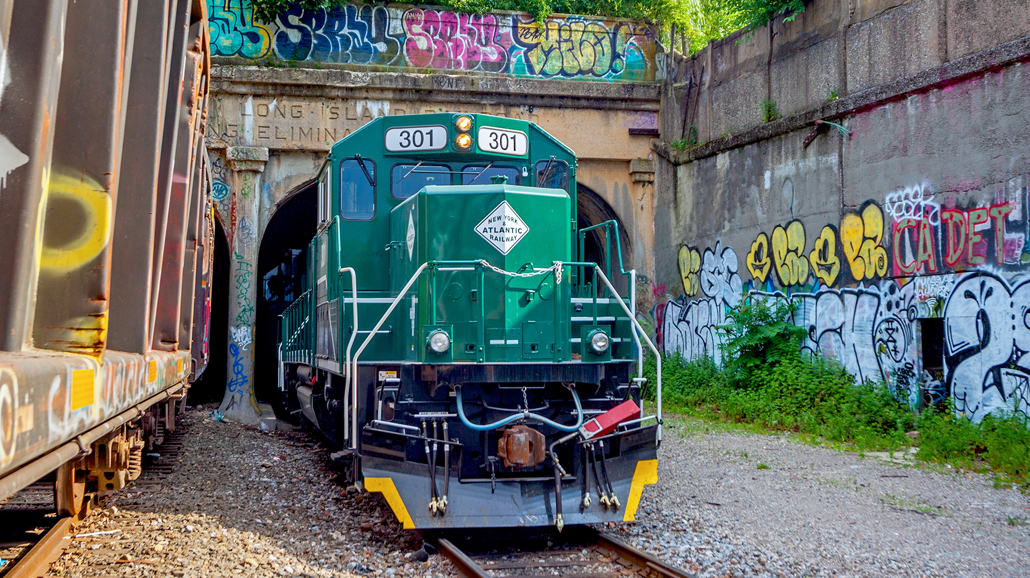
New York & Atlantic Railway
Transportation
Research Forum
-NYC Chapter
12.17.21

Slide 2
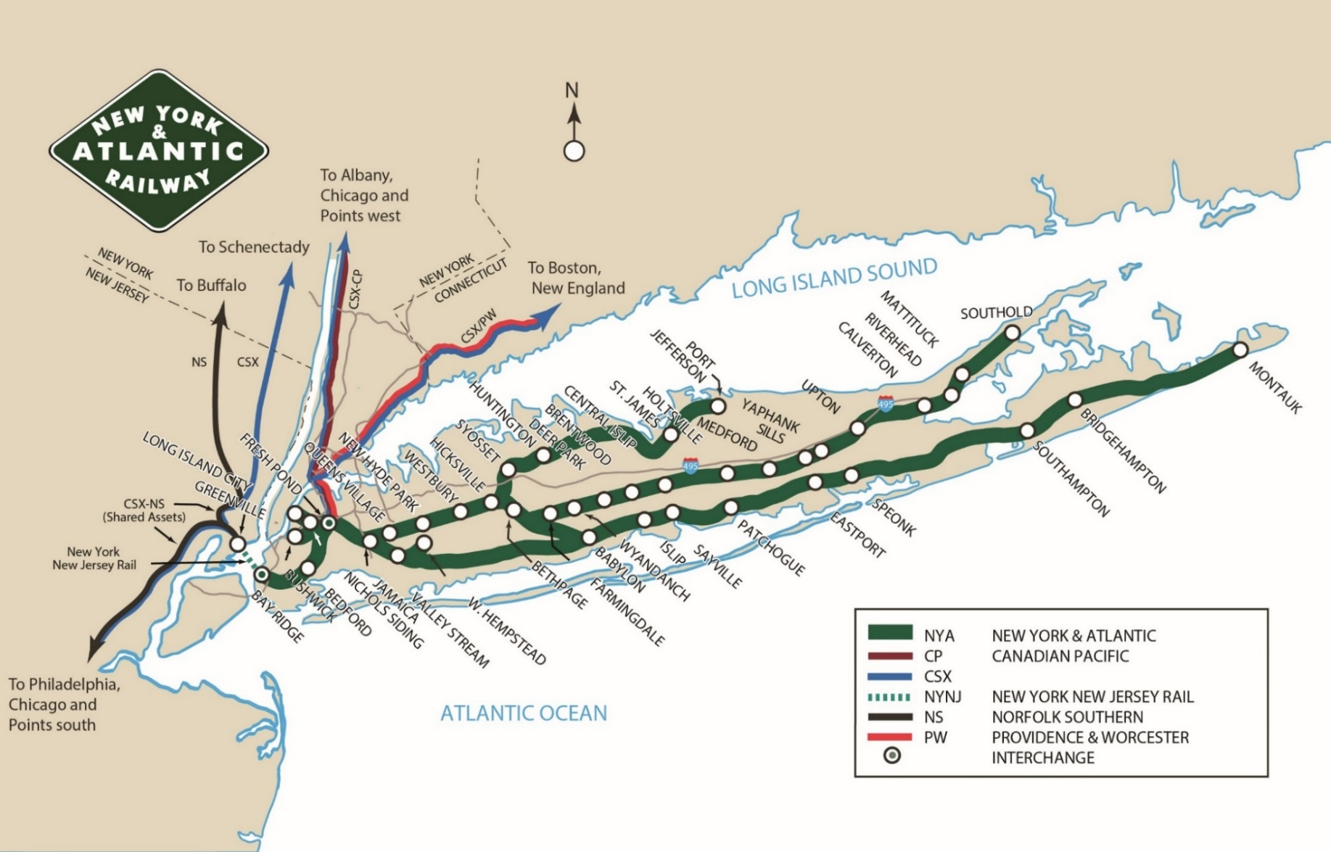
Network
All of Queens, Brooklyn, and Long Island

Slide 3
Growth
Formed in 1996
Earned the right to operate LIRR’s freight license through a competitive bid process
Tasked with increasing freight rail share
80+ customers
Broad commodity mix handled
Complex operating environment
Increasing demand
NYA carload growth ‘00-’21 (projected)
Notes:
Kinda hard on the eyeballs

Slide 4
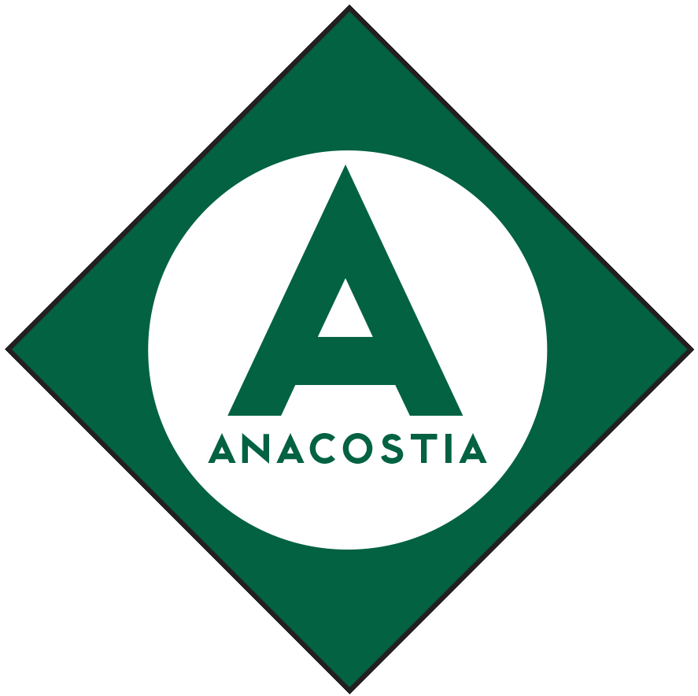
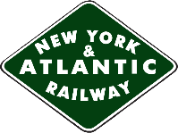
Balance
Public Benefit
Jobs
Community
Solvency
Commuters
NYA
Notes:
Can you get the bottom banner / logos back on top? Think the letters stand out okay?

Slide 5
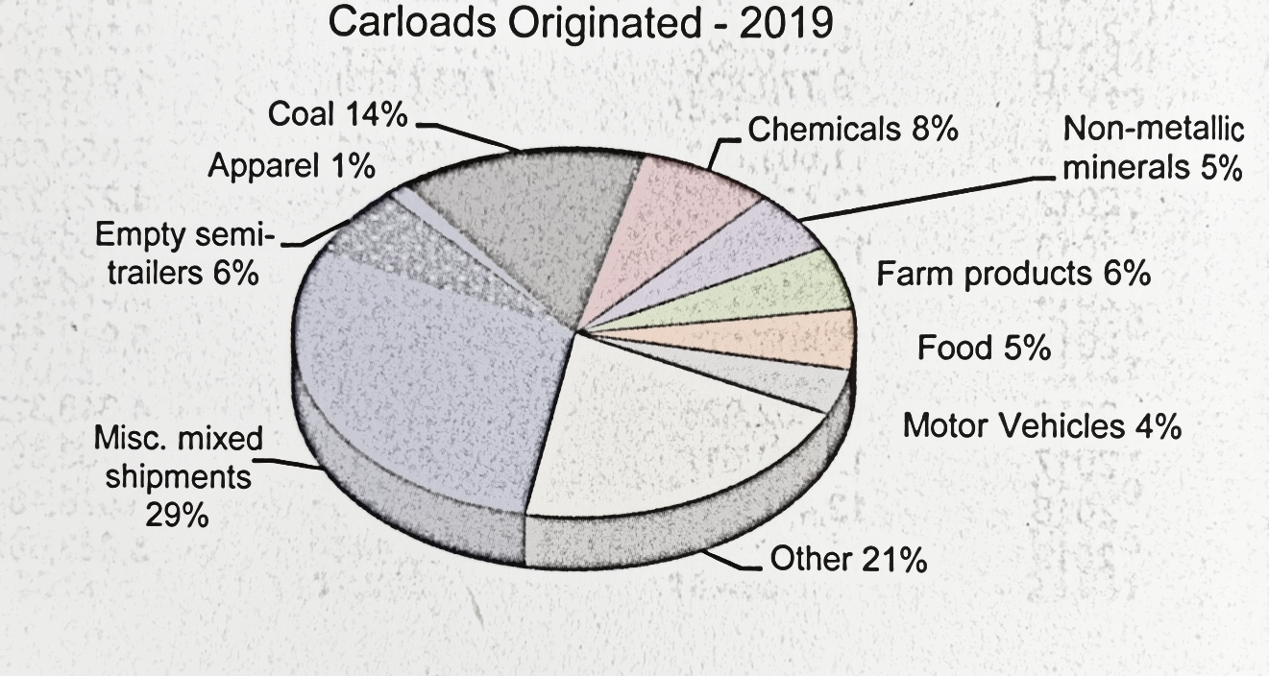
Market reach

Slide 6
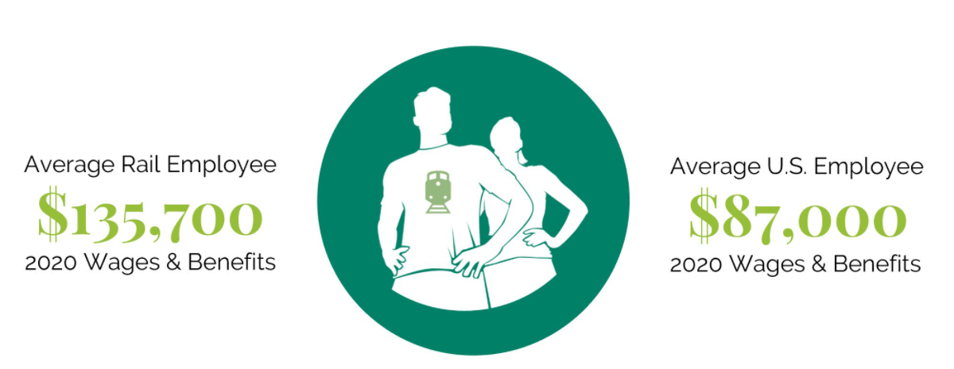
Employees
NYA employs 60 full-time personnel
Average non-supervisory annual compensation for NYA is well above U.S. average
3+ years of training to become a locomotive engineer
Headcount has increased 38% in the last 10 years
Local workforce
Rigorous safety training and standards

Slide 7
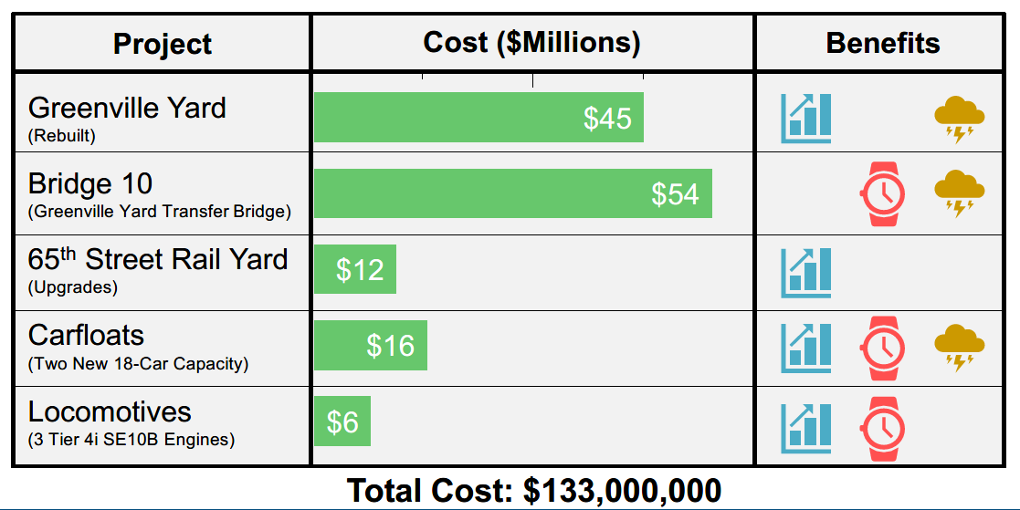
Partners
Connects through Conrail to Norfolk Southern and CSX network
Wholly owned by PANYNJ
Vital connection for competitive access and network redundancy

Slide 8
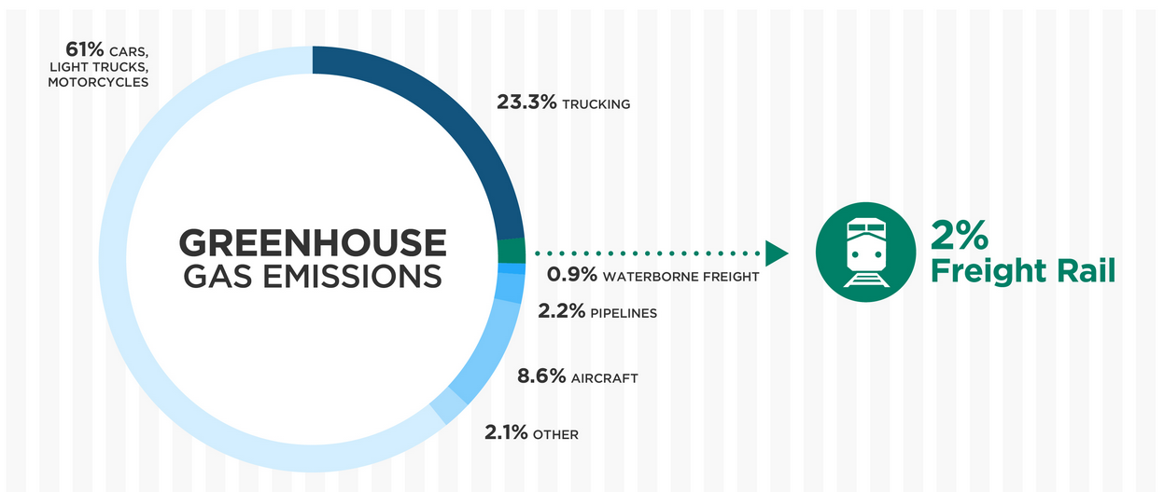
Environment
Partnering with LIRR to acquire lowest emission units available
Significantly less carbon footprint vs other transportation modes
A single freight train is equivalent to hundreds of trucks off the road
Rail moves 1/3 of export, yet accounts for only ~2% of emissions*
Railroads move one ton of freight an average of 470 miles on one gallon of fuel*
Moving 5% more freight from truck to rail would result in 9 million fewer tons of greenhouse gas emissions*
*American Association of Railroads, 2019
EPA, Inventory of U.S. Greenhouse Gas Emissions and Sinks: 1990-2016

Slide 9
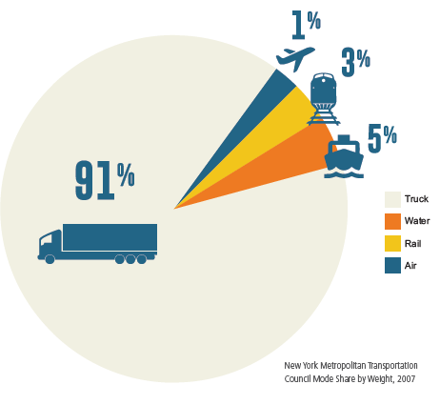
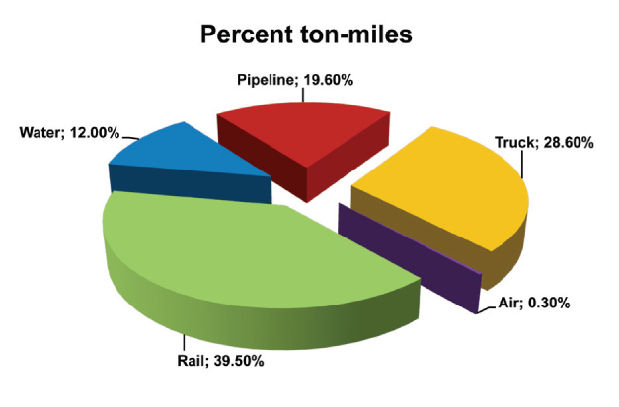
Market Share
National
NYC Metropolitan Region
Federal Railroad Administration,
"National Rail Plan Progress Report", September 2010.

Slide 10
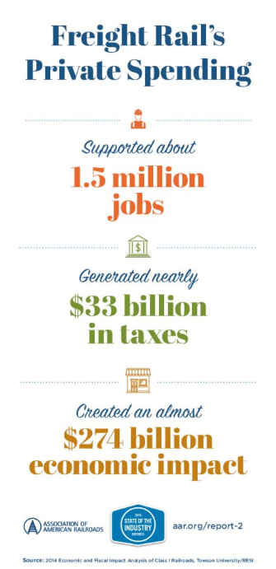
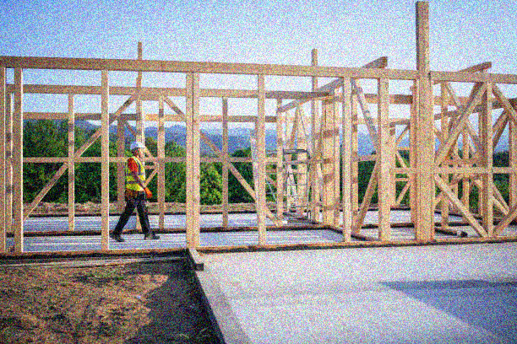
Impact
Inrix Global Traffic Scorecard, 2020

